Slide 1

Cargo aircraft tiedown devices analysis and test
Notes:
Background/Introduction (10 Points)
Describe the background of the system you are analyzing.
Why is there interest in this topic? If it feeds your research, explain how.
Methodology:
Calculations (20 Points)
What calculations did you perform and why?
Show equations and/or sample calculations.
What assumptions did you make?
How were these calculations helpful?
Other Analytical Methods (Computation, experimentation, etc.) (20 Points)
What other methods did you perform?
What tools were employed? (Software packages, test equipment, etc)
How did your calculations relate to, inform, or compare with your other analysis methods?
Results and Discussion (20 Points)
Present results
Discuss noteworthy items in results
If in scope, show how calculations relate to your other analytical methods.
Conclusions (20 Points)
What conclusions can be drawn?
What utility can be drawn from this work? I.e., did this work provide the expected outcomes? For example, if you performed this work on an aspect of your thesis, did it help provide the answer you expected? In some cases the answer may be, “I found this interesting, and it helped me understand more about the topic.”
References (10 Points)
Include a list of references
Be sure to show attribution for figures that you did not create

Slide 2
Agenda
Background
ATTLA
AFIT
Analysis
Hand calculations
Finite Model
Test
Results & Conclusions

Slide 3
Background: AFIT
Air Force Institute of Technology (AFIT) at Wright Patt (Area B)
Free for DoD civilians
Offers ABET accredited graduate degrees such as:
Aeronautical
Electrical
Computer Engr
Physics
Operational Sciences
Many notable alumni graduated from AFIT including NASA astronauts
Leading research in hypersonics and additive manufacturing
Requirements for admission for each program are slightly different. Most require GRE.
If you have questions on joining AFIT contact me

Slide 4
Background: ATTLA
What ATTLA does
Certify cargo for air transport and airdrop on C-130, C-17, and C-5
Provide a certification letter to customers
Primary responsibilities
Crew safety
Maintain airworthiness
Effective transport
We certify cargo per:
MIL-STD-1791D (air transport)
MIL-STD-1791-1 (airdrop)
MIL-STD-209K (Army std for tiedown provisions)

Slide 5
Background: Restraint requirements
Cargo need to be restrained safely while being transported or staged for airdrop to endure flight loads and survive critical conditions such as hard landings, sudden accelerations, hard maneuvers etc. (MIL-STD-1791D Table IV)
3G FWD (Ultimate)
1.5G AFT (Ultimate)
1.5G Lateral (Ultimate)
2G Up (Limit)
4.5G Down (Limit)
NOTE: FAA uses similar values on the commercial / civilian side (ref: FAA 14 CFR Part 25)
Method of restraint is using tiedown devices to achieve those required restraints

Slide 6
Background: AFIT
MECH545: Aerospace Structural Engineering
Final project worth 25% of grade involved picking any topic related to structural engineering.
Perform proper analysis and testing if applicable
Topic: Restraint tiedown devices.

Slide 7
Why analyze tiedown devices?
Validate existing standards
Are the ratings actually valid?
Can the devices and chain sustain the required loads?
Safety margins verification
Per MIL-STD-1791D, tiedown chains have a safety factor of 1.5 while tiedown devices have a 2.5 safety factor. Thus, the chain should fail first.
Failure analysis
Why they failed?
How they failed?
Risk and safety management

Slide 8
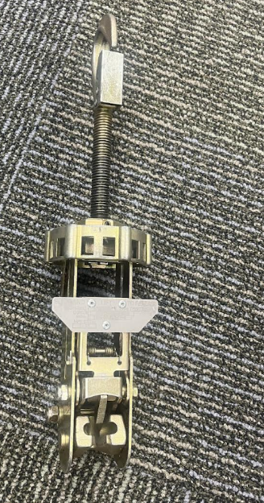
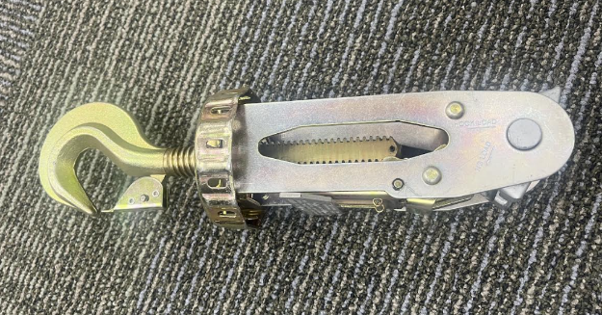
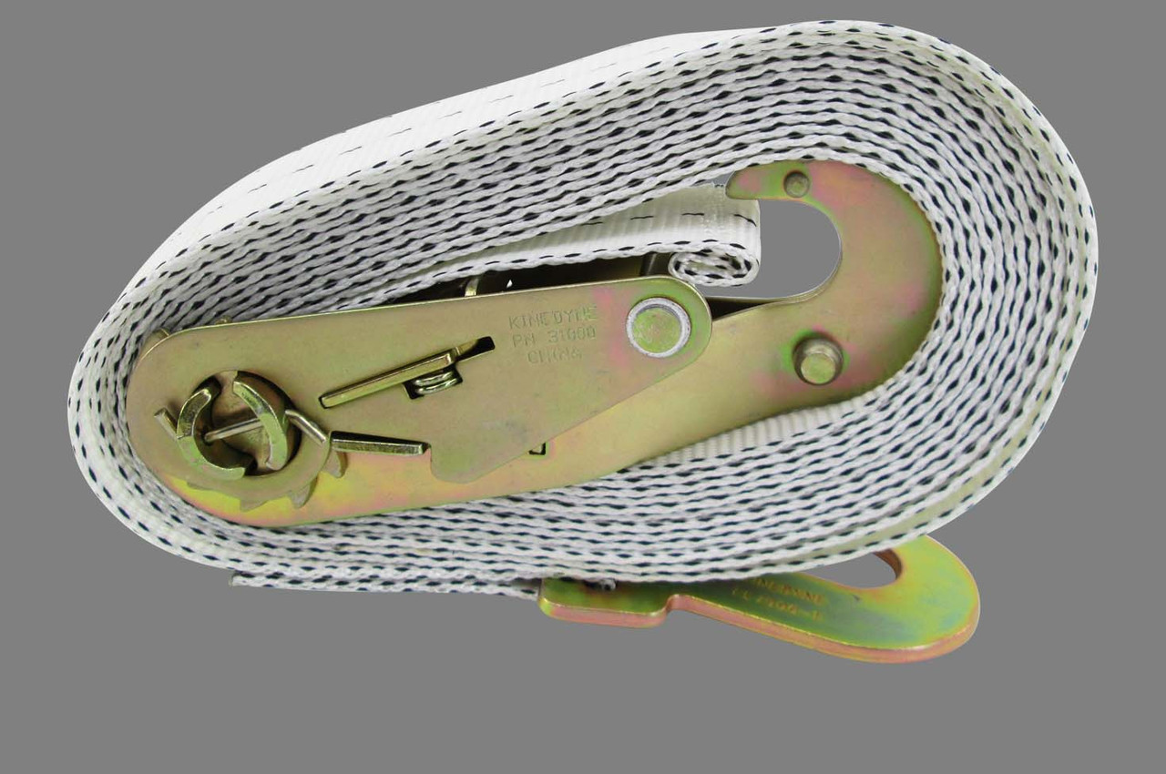
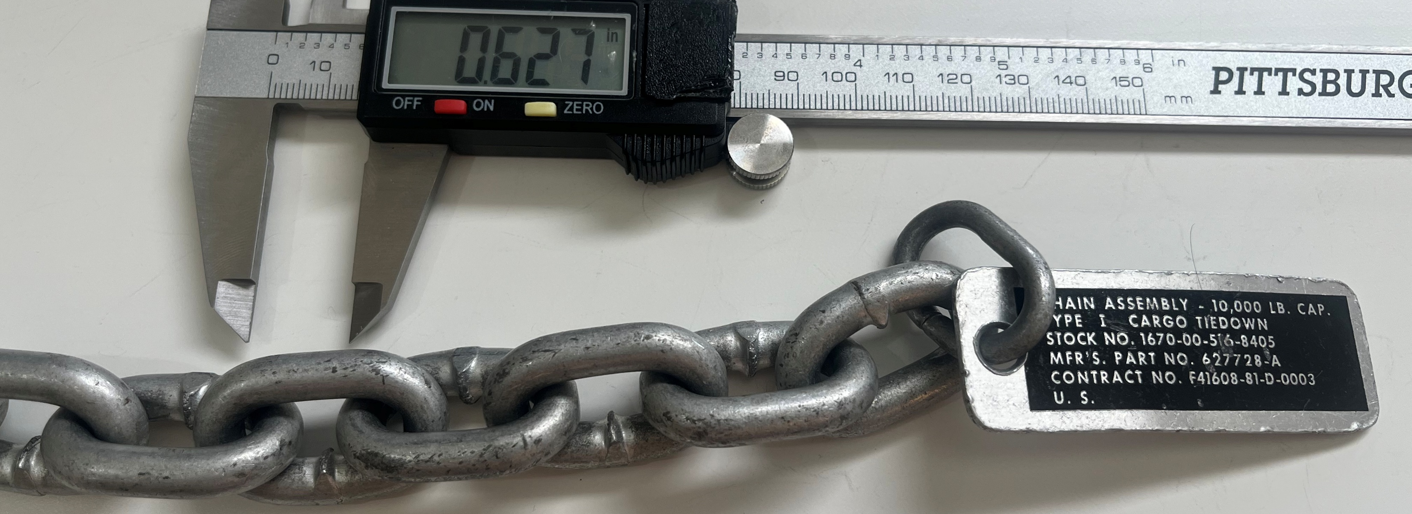
Tiedown devices and chains
Three types commonly used on C-130, C-17, C-5 (comes pre-equipped)
CGU-1/B (5k)
CGU-8/A (10K LBF)
CGU-7/A 25K LBF
Tiedown Chain (10k LBF)

Slide 9
Number of tiedown devices on cargo aircraft
Tiedown device | C-130A-H | C130J | C-130J-30 | C-17 | C-5
CGU-1/B (5k) | 40 | 40 | 40 | 50 | 50
CGU-8/A (10k) | 34 | 34 | 34 | 46 | 75
CGU-7/A (25k) | 6 | 6 | 6 | 46 | 75
Floor Tiedown Rings (lbs.) | 10,000 (Floor) 25,000 (3 fore, 2aft) | 10,000 (Floor) 25,000 (2 aft) | 10,000 (Floor) 25,000 (2 aft) | 25000 | 25000
Table: Cargo aircraft tiedown devices and rings
Notes:
Separate slide

Slide 10
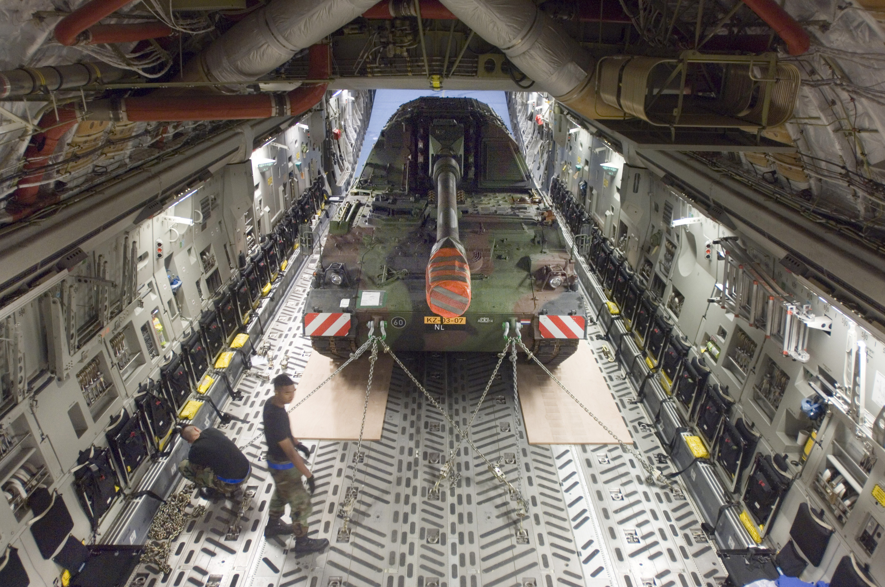
Vehicle tiedown on C-17
Figure: Howitzer transported to Afghanistan on a C-17

Slide 11
Analysis
Hand calculations
Scenario 1, Ideal
Scenario 2, Practical
Finite Element Model

Slide 12
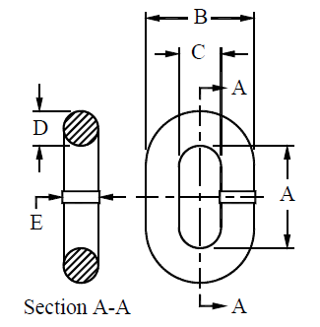
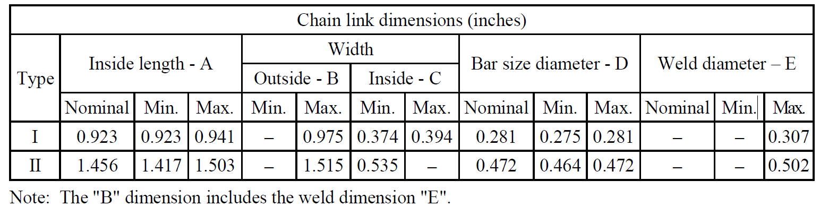
Analysis: Tiedown Chains
MIL-DTL-6458H: Chain Specifications
Does not specify a material
Conforms to ASTM A304, ASTM A322, ASTM A108 or equivalent heat treated
Figure: Chain link dimensions and cross section

Slide 13
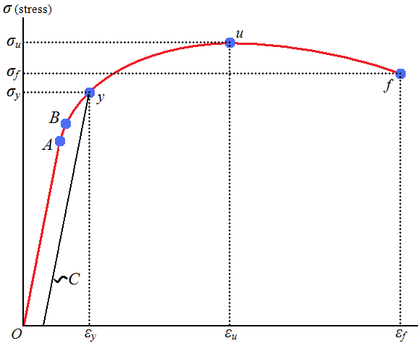
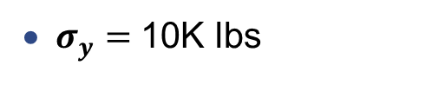

Proof load vs Ultimate Load
MIL-DTL-6458H: Chain Specifications :
Proof load of 10,000 pounds (no permanent deformation)
Ultimate load of 14,100 pounds (deformation without rupture or visible cracks)
$σ_{u}=$14.1K lbs
$σ_{y}=$10K lbs
Figure: Engineering Stress-Strain Curve for ductile material

Slide 14

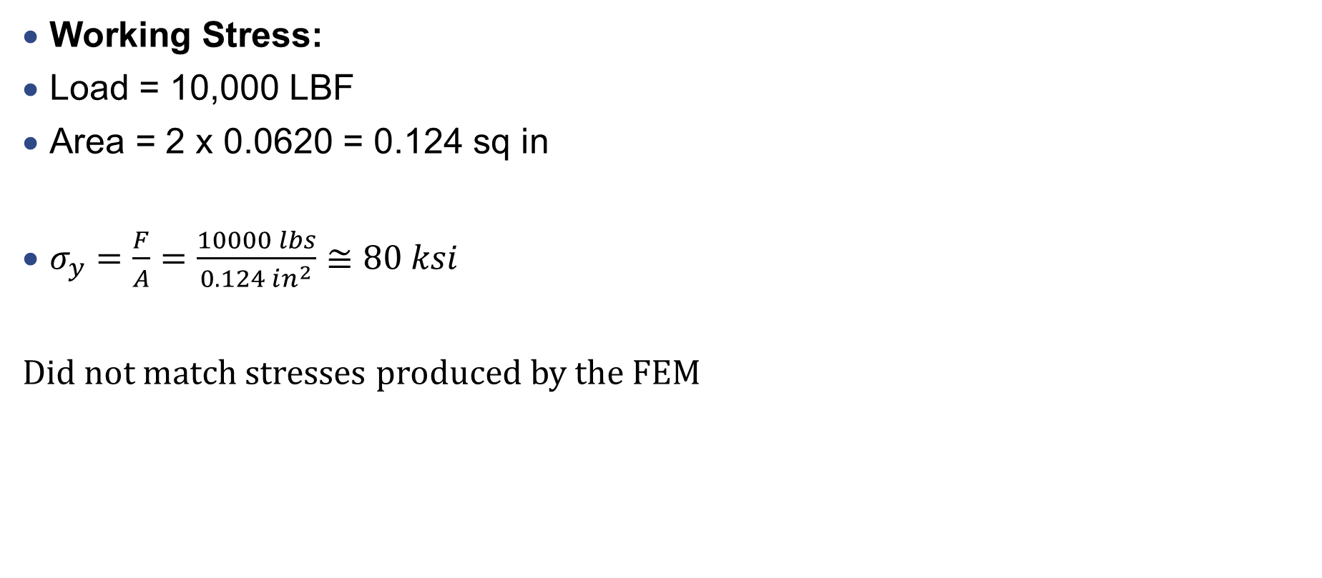
Chain Analysis: Ideal Scenario (Tensile Load)
Working Stress:
Load = 10,000 LBF
Area = 2 x 0.0620 = 0.124 sq in
$σ_{y}=\frac{F}{A}=\frac{10000 lbs}{0.124 in^{2}}≅80 ksi$
Did not match stresses produced by the FEM
5K LBF
5K LBF
Figure: Working load applied on tiedown chain
Notes:
C = 0.384 avg
Ri = Inner radius = C/2 = 0.192
Rc = Ri + Rbar = 0.3295 in
Rn = Rbar^2 / 2(Rc-sqrt(Rc^2 – Rbar^2) = 0.3145 in
Seely & Smith, Advanced Mechanics of Materials, 2nd ed

Slide 15
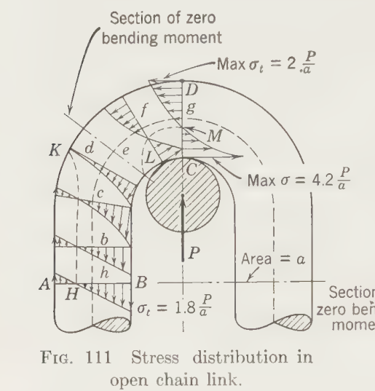
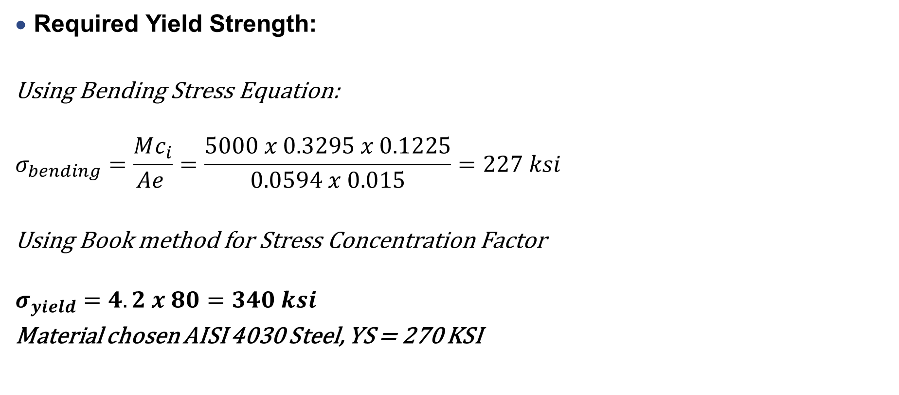
Chain Analysis: Practical Scenario (Bending Moment)
Required Yield Strength:
Using Bending Stress Equation:
$$σ_{bending}=\frac{Mc_{i}}{Ae }=\frac{5000 x 0.3295 x 0.1225}{0.0594 x 0.015}=227 ksi$$
Using Book method for Stress Concentration Factor
$$σ_{yield}=4.2 x 80=340 ksi$$
Material chosen AISI 4030 Steel, YS = 270 KSI
Source: Adv. Mech of Materials 2nd Ed
Notes:
C = 0.384 avg
Ri = Inner radius = C/2 = 0.192
Rc = Ri + Rbar = 0.3295 in
Rn = Rbar^2 / 2(Rc-sqrt(Rc^2 – Rbar^2) = 0.3145 in
Seely & Smith, Advanced Mechanics of Materials, 2nd ed

Slide 16
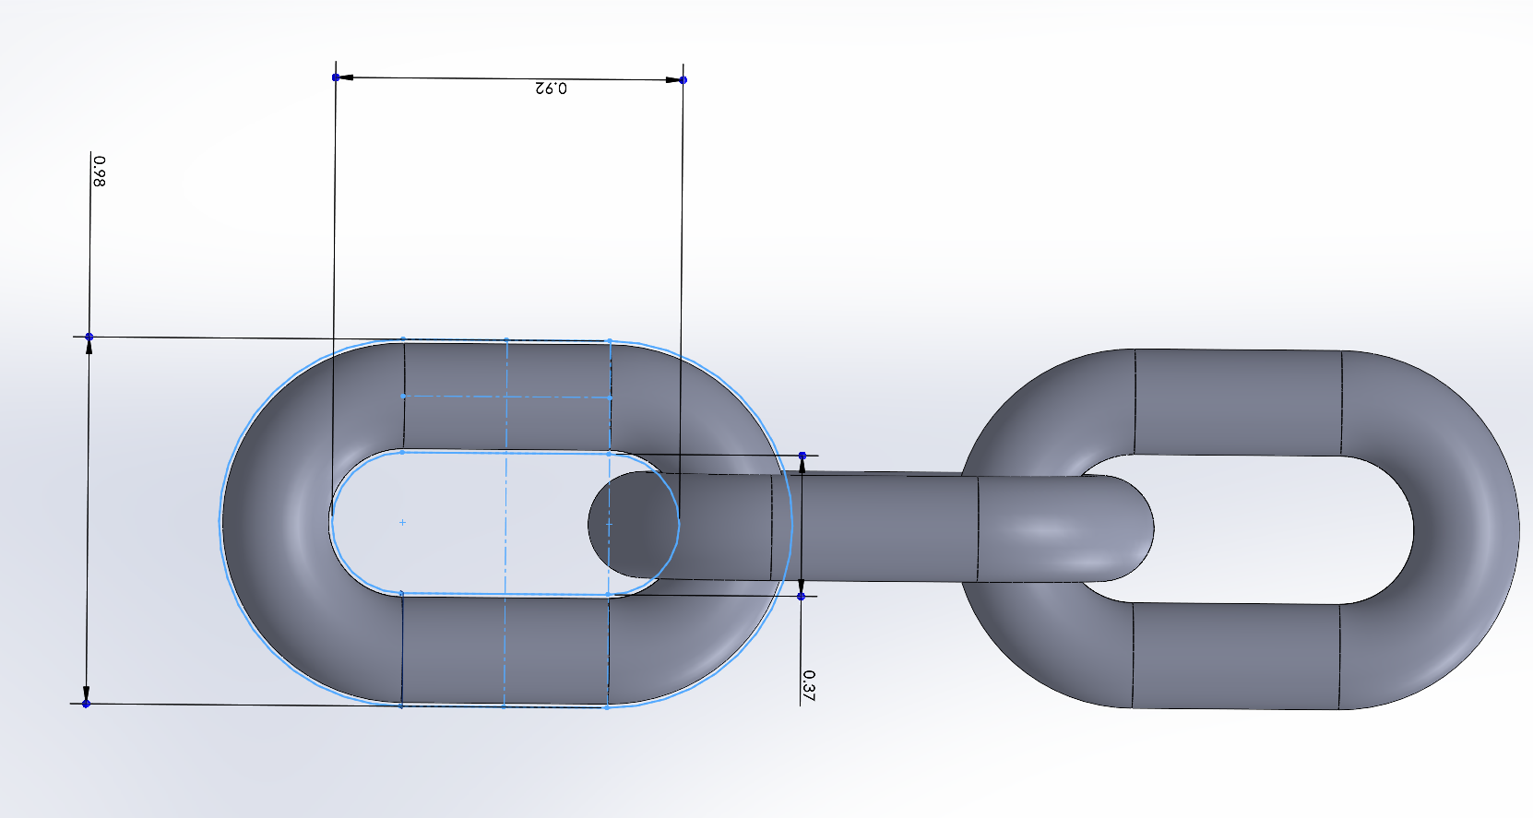
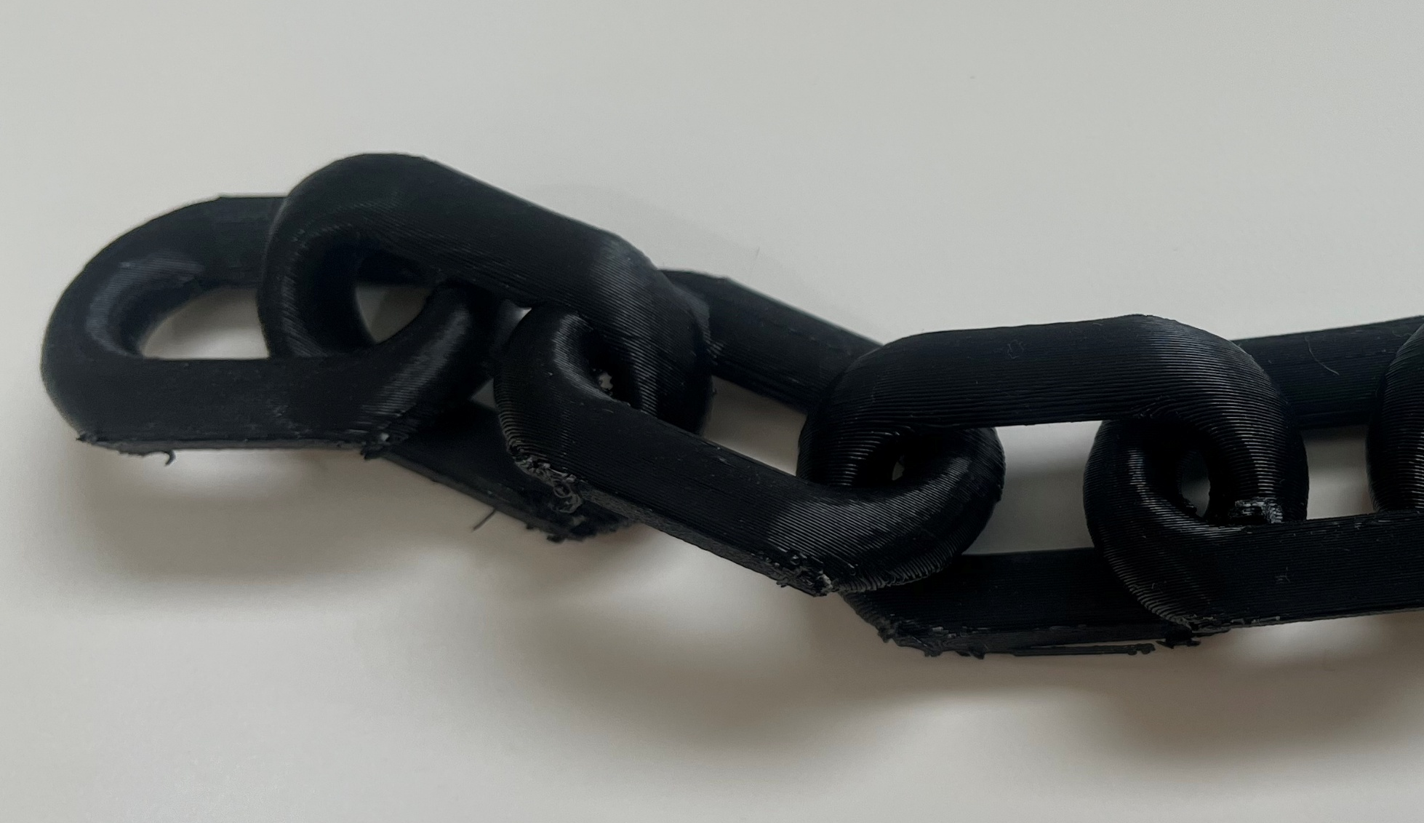
Chain CAD Model
Type I Chain (10K LBF) modeled in SolidWorks using nominal dimensions
Figure: Type I chain, three links CAD Model

Slide 17
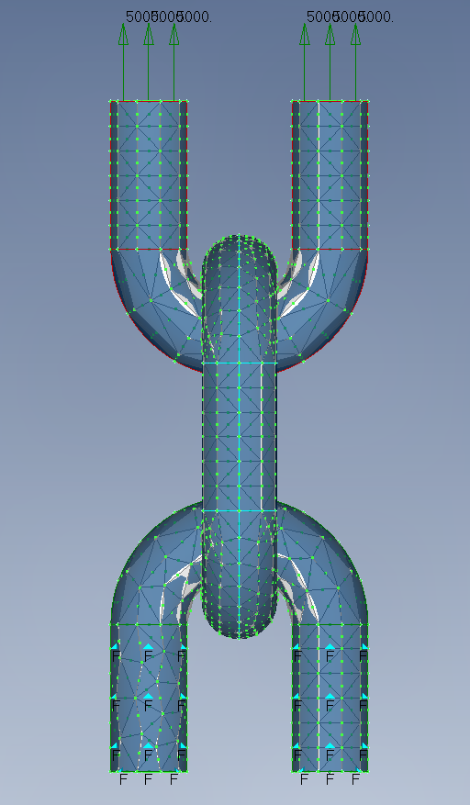
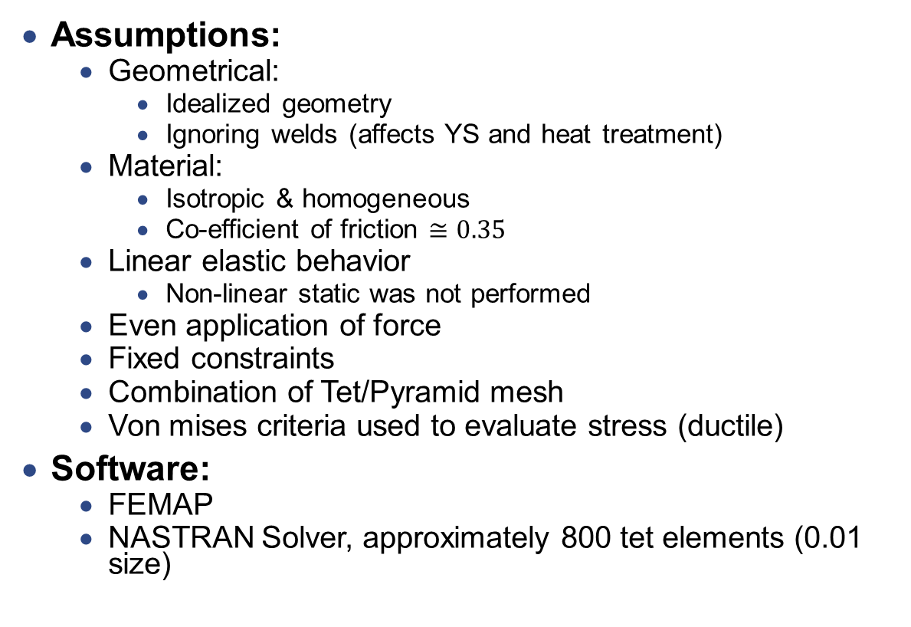
FEA Analysis
Assumptions:
Geometrical:
Idealized geometry
Ignoring welds (affects YS and heat treatment)
Material:
Isotropic & homogeneous
Co-efficient of friction $≅0.35$
Linear elastic behavior
Non-linear static was not performed
Even application of force
Fixed constraints
Combination of Tet/Pyramid mesh
Von mises criteria used to evaluate stress (ductile)
Software:
FEMAP
NASTRAN Solver, approximately 800 tet elements (0.01 size)

Slide 18
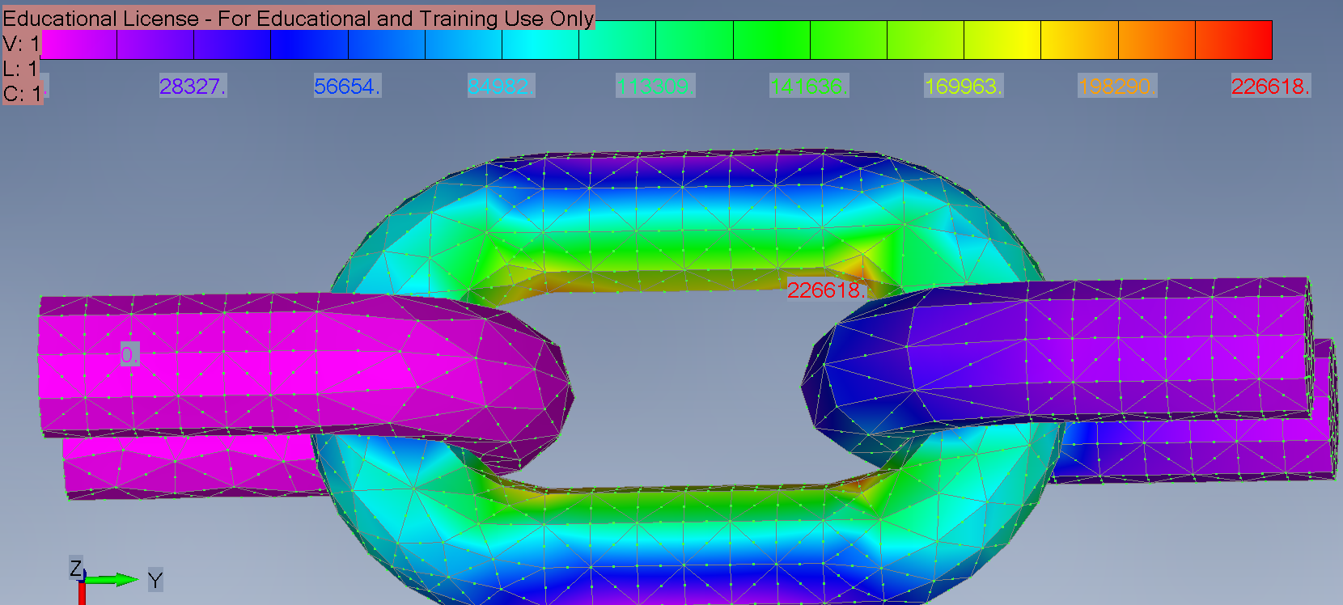
FEA Results: 10K LBF Von-Mises
Applied load: 10K
Peak stress:
227 ksi
Below AISI 4340 Alloy Steel YS
Figure: Translation contour to scale, von-mises deformation

Slide 19
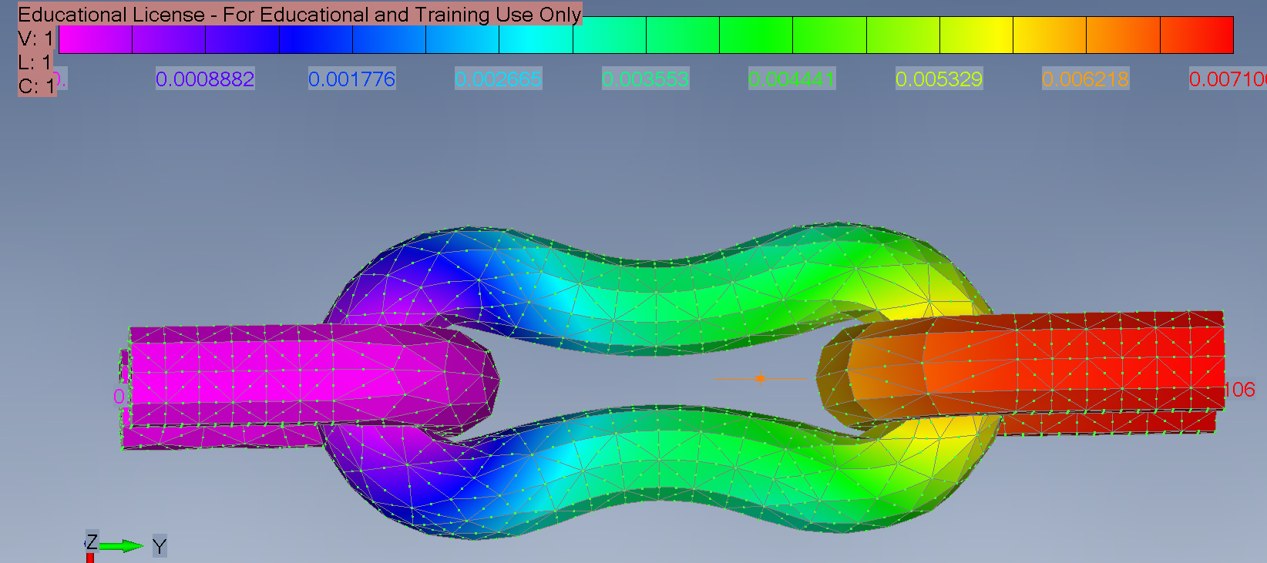
FEA Results: 10K LBF Deformation
Applied load 10K
Peak deformation:
0.006 inches on middle link
(not to scale)
Figure: Translation contour (not to scale), translation deformation

Slide 20
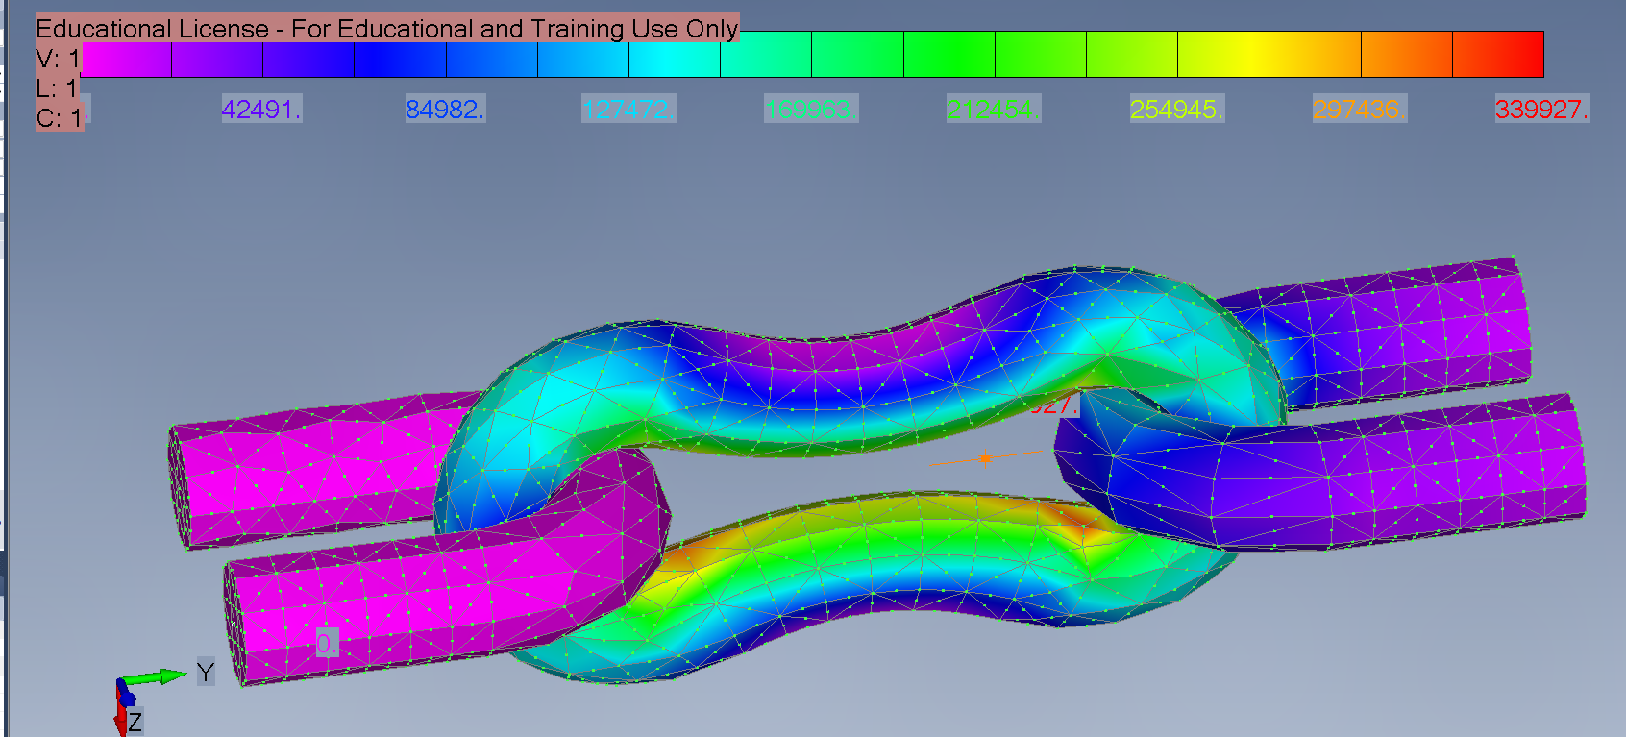
FEA Results: 15K LBF Von-Mises
Applied load: 15K
Peak stress:
340 ksi
Exceeds AISI 4340 Alloy Steel YS
Stress concentration
around the edge
Figure: Translation contour (not to scale), von-mises deformation

Slide 21
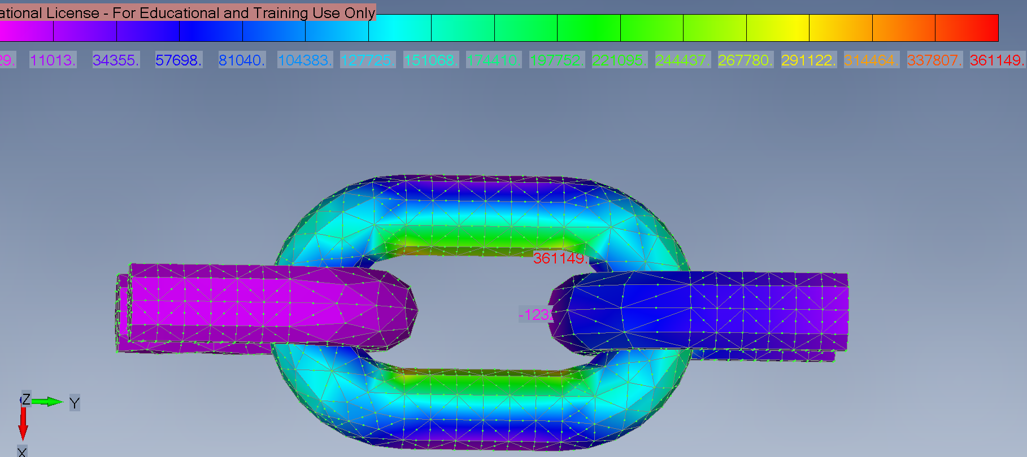
FEA Results: 15K LBF Max Principal Stresses
Applied load: 15K
Peak stress:
360 ksi
Figure: Translation contour (not to scale), von-mises deformation

Slide 22
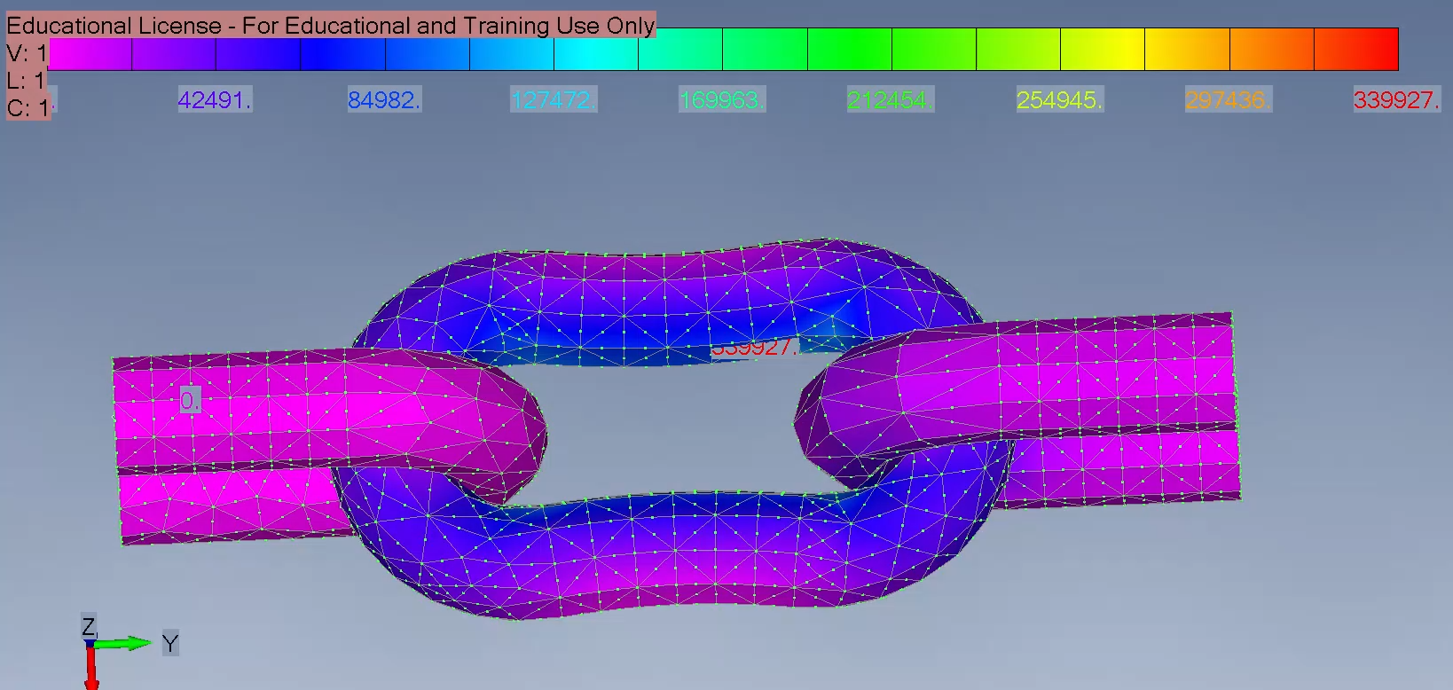
FEA Results: 15K LBF Animation

Slide 23
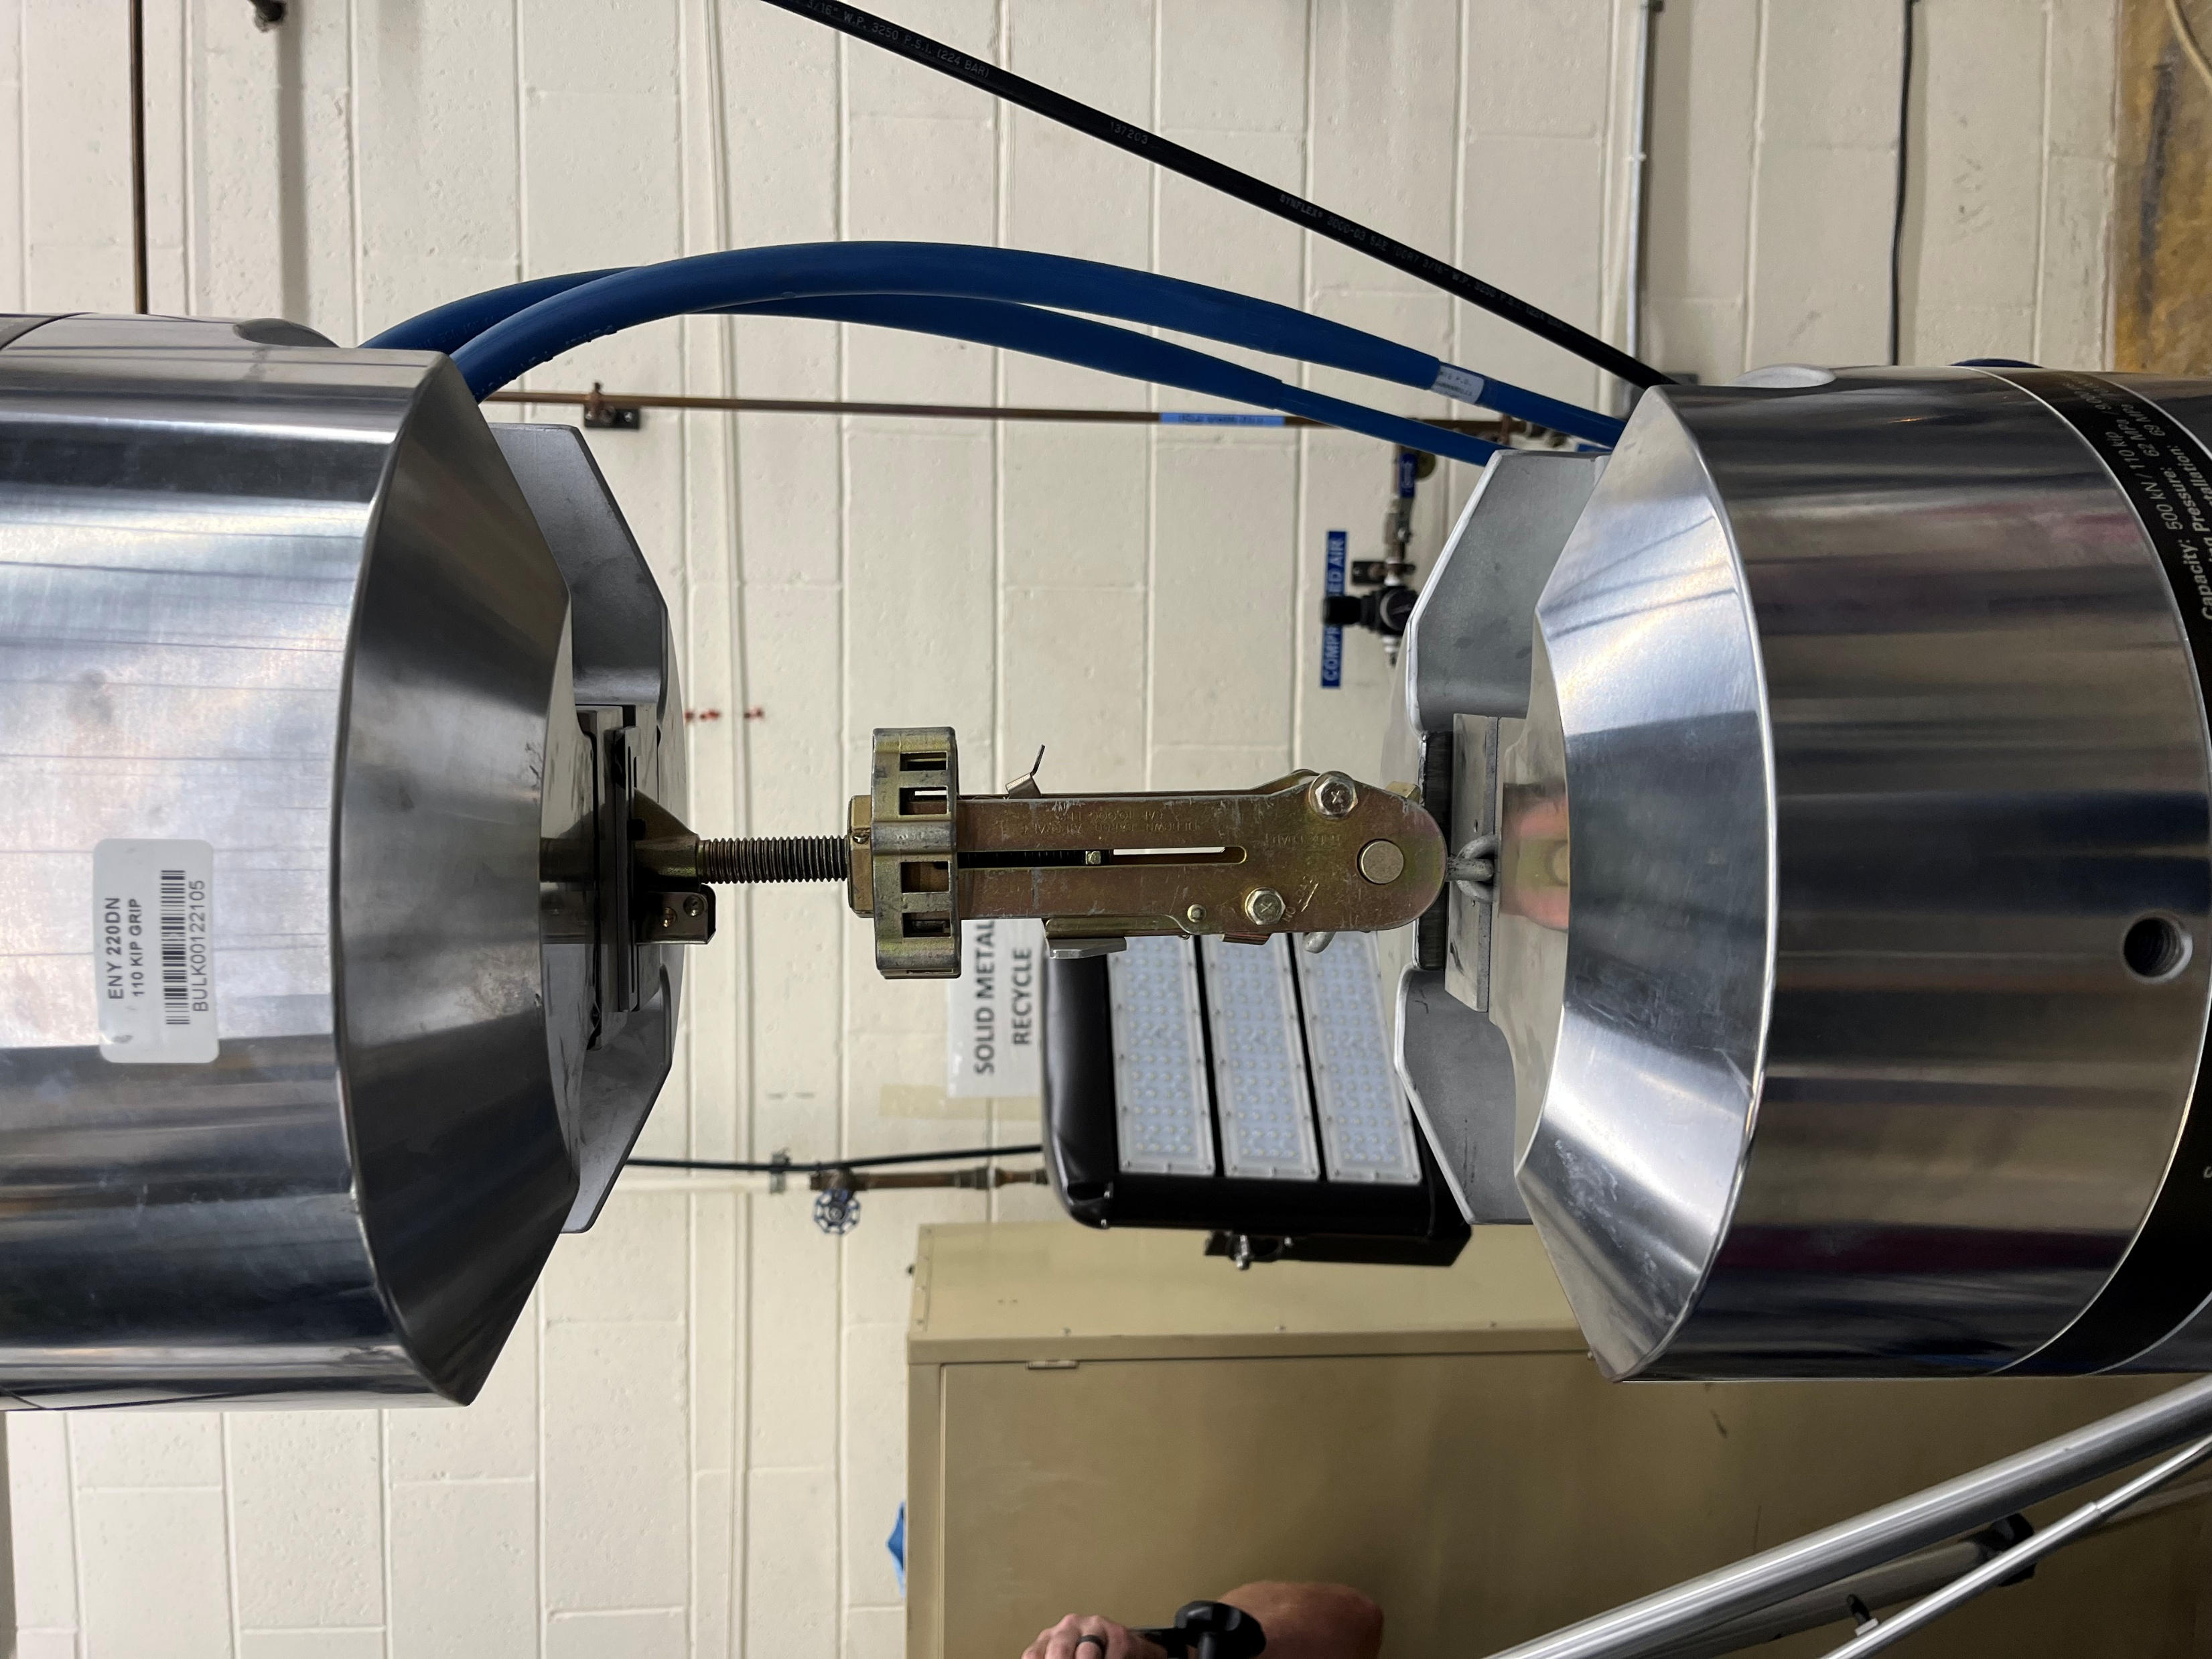
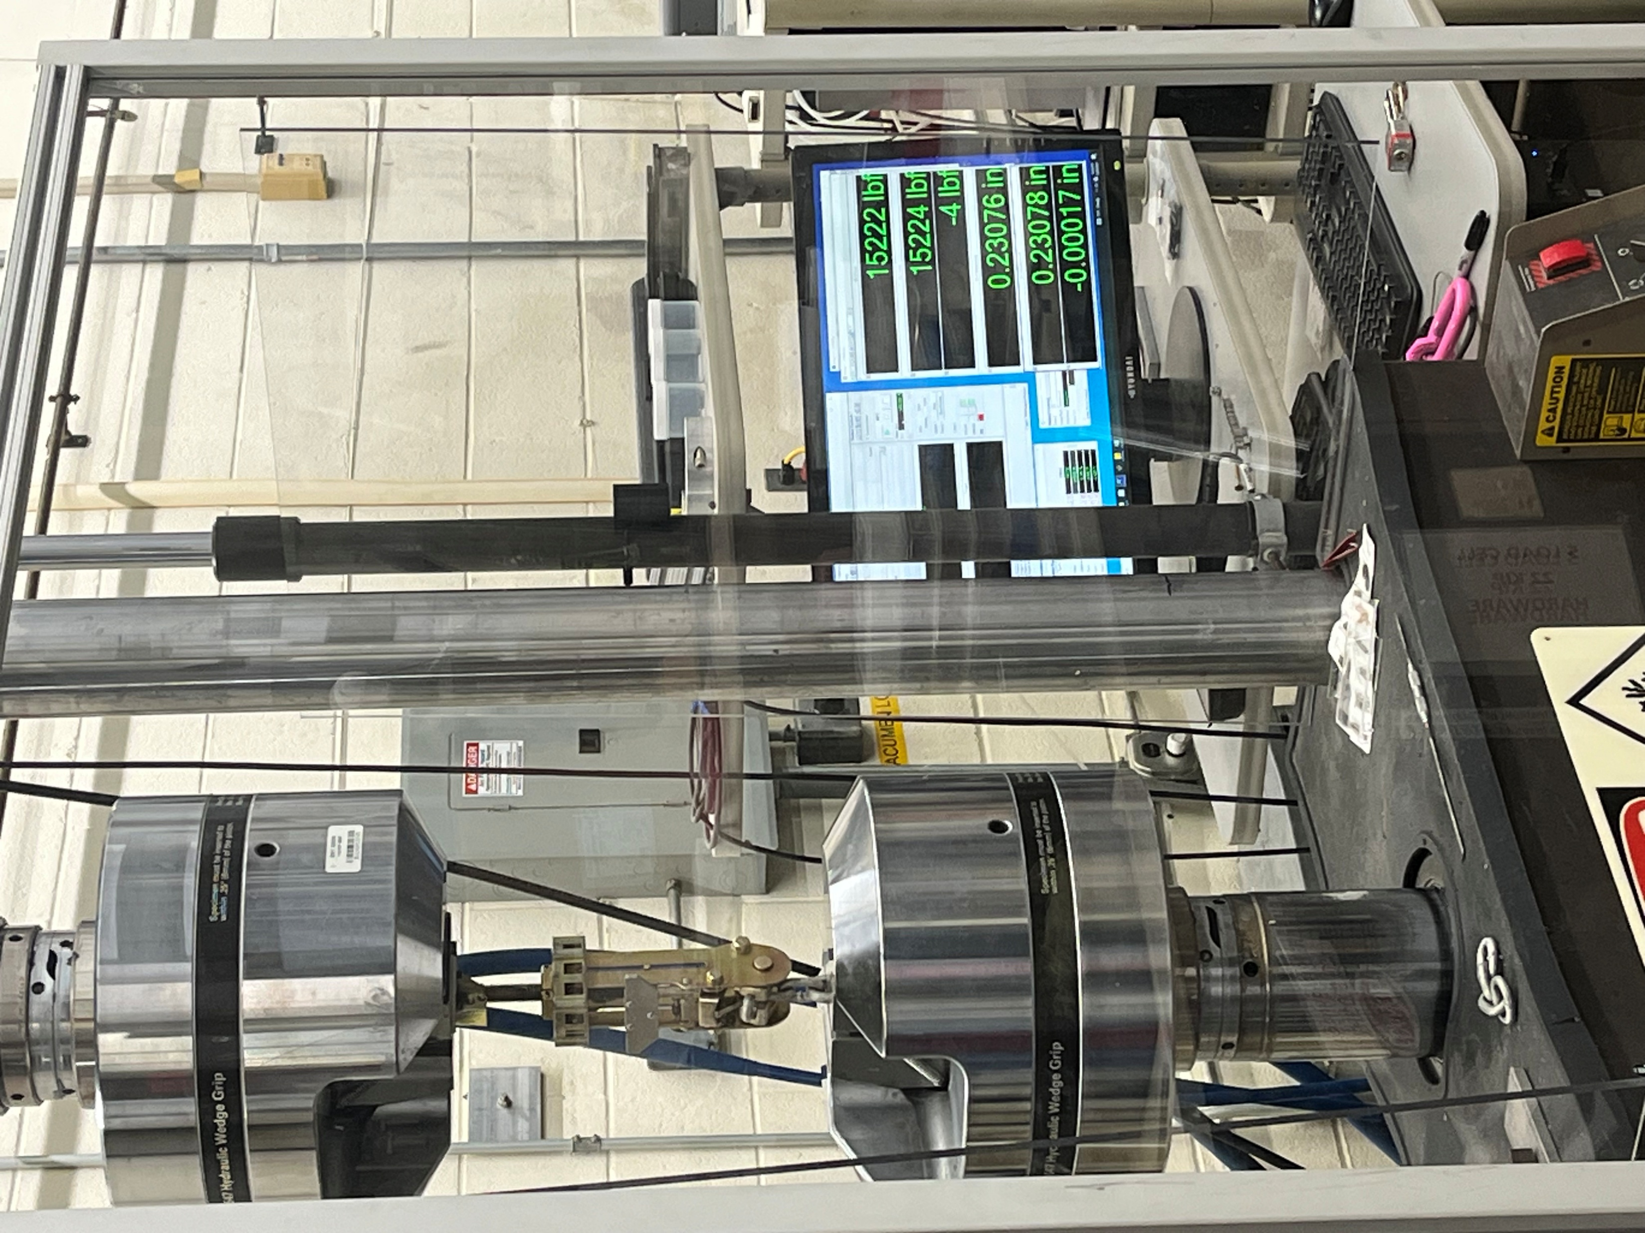
Testing the tiedown device and chain
Tested on MTS systems in the lab
Displacement controlled (0.002 mm/s)
Limitations:
Not enough sample size
Condition and age of samples

Slide 24
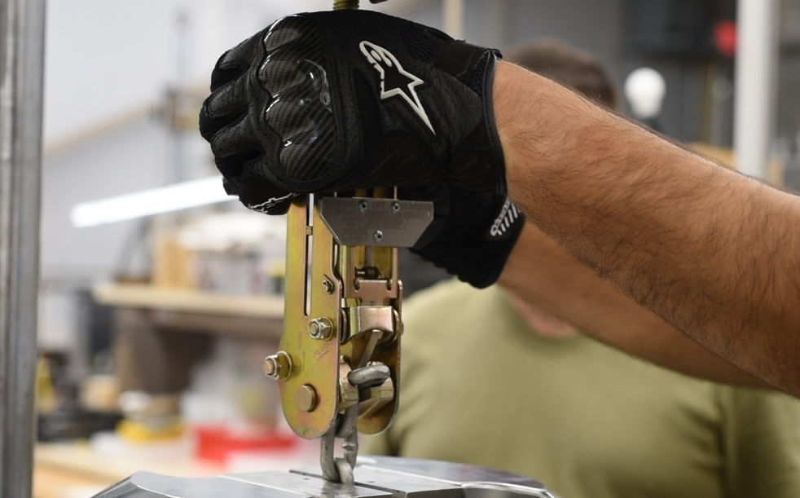
Testing maximum force applied just by hand tightening
How much force can be applied just by hand?
Loadmasters typically wear gloves which enhances grip strength

Slide 25
Force applied by hand tightening
Average 1200 lbf applied just by hand
Collect more samples from the 95th percentile subset of loadmasters

Slide 26
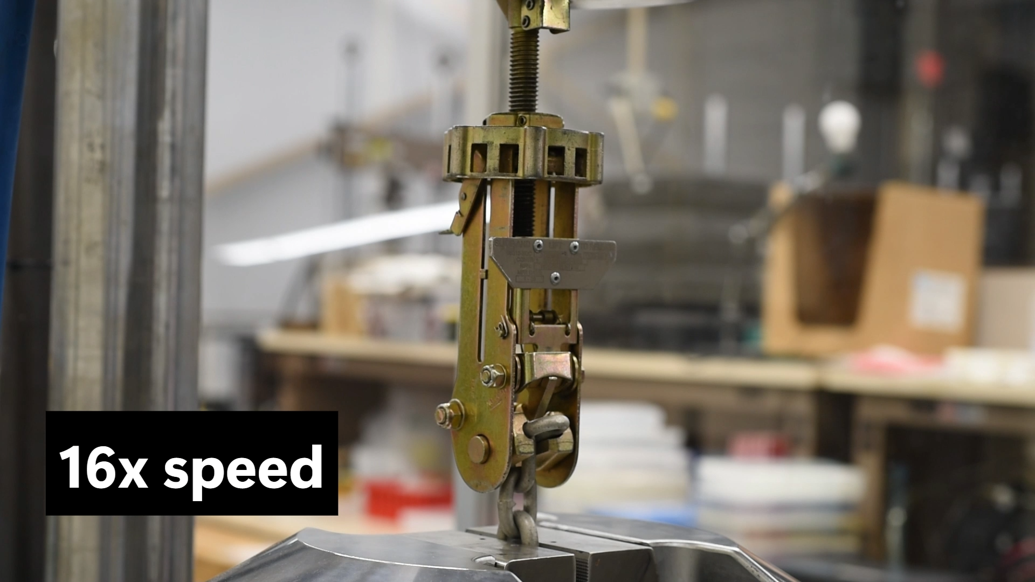
MTS Pull test #1

Slide 27
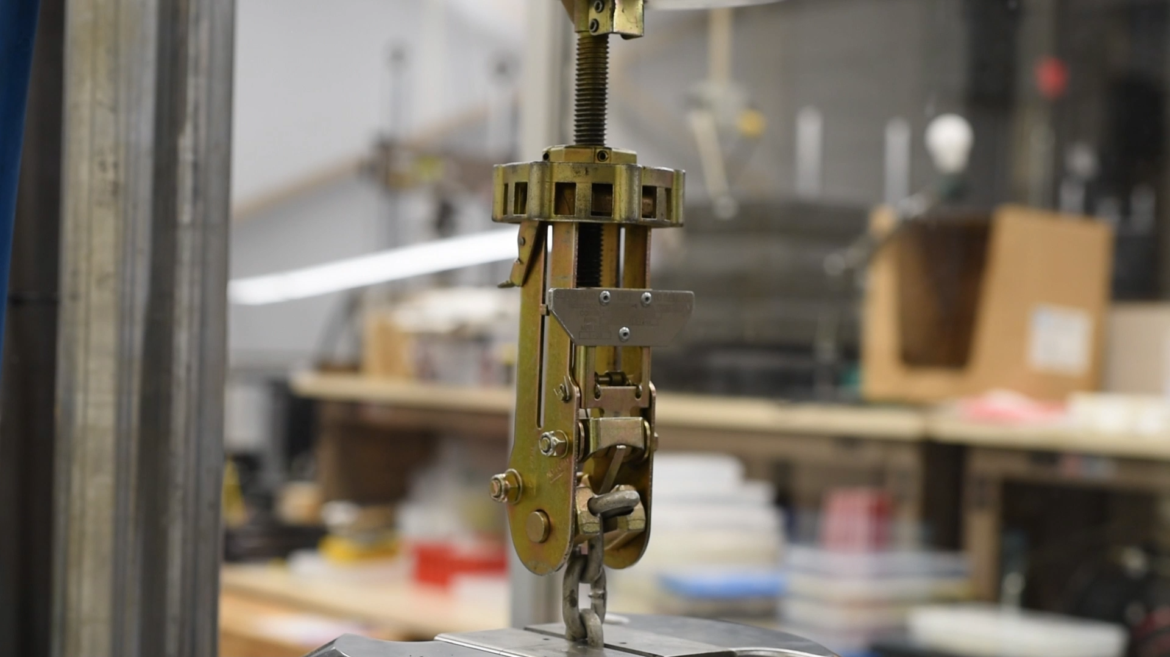
MTS Pull test #2

Slide 28
Results
Failure method: Fracture, no trivial failures at boundaries
Test #1
Peak Force: 15,708 LBF
Displacement at fracture: 0.298 in
Test #2
Peak Force: 15,653 LBF
Displacement at fracture: 0.306 in

Slide 29
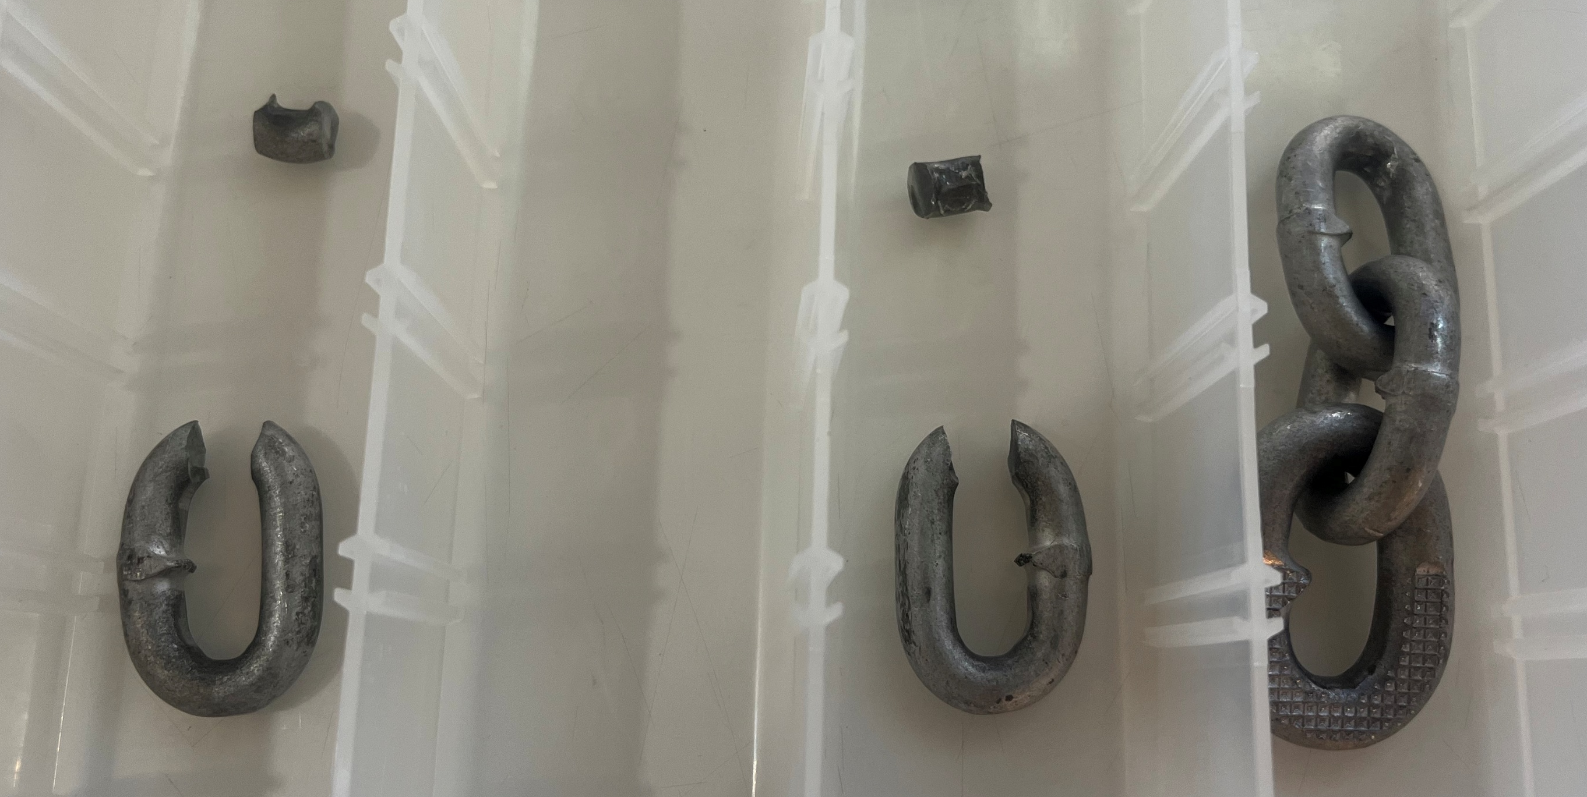
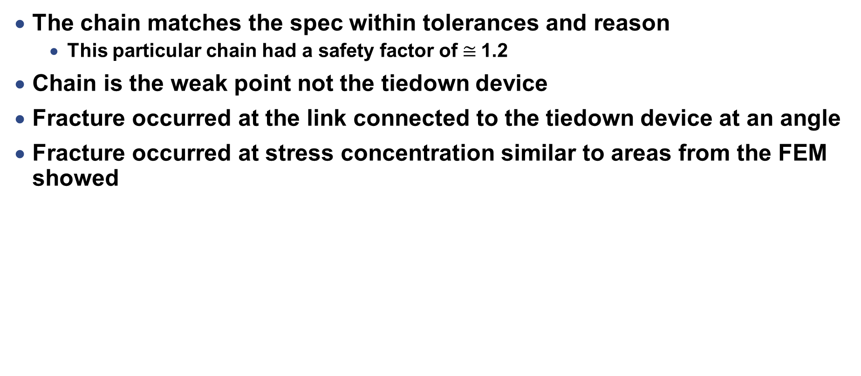
Results & Conclusion
The chain matches the spec within tolerances and reason
This particular chain had a safety factor of $≅$1.2
Chain is the weak point not the tiedown device
Fracture occurred at the link connected to the tiedown device at an angle
Fracture occurred at stress concentration similar to areas from the FEM showed
Test #1
Test #2

Slide 30
Future tests
Figure out exact material used by OEMs for the chain
Model the chain at an angle when doing the FEM
Collect more samples
Analyze 25K chain
Analyze tiedown devices

Slide 31
References
MIL-STD-1791D: Designing for internal Aerial Delivery in fixed wing
MIL-STD-209K: Interface standard for lifting and tiedown provisions
MIL-DTL-6458H 10K & 25K Tie Down Chains Spec
Seely & Smith, Advanced Mechanics of Materials, 2nd ed
Special thanks to MSgt Herrier and Maj Brewer

Slide 32
Questions?

